Slide 1
Ownership-Based Memory Safety Rules in the Rust Compiler
{
}
< How Rust Keeps up With C Without all its Footguns >
...

Slide 2

Footguns you say?
Footgun (noun):
A tool so powerful, it’s more likely to shoot you than solve your problem. Common in C, where freedom and disaster go hand in hand.
> Urban Dictionary, Probably

Slide 3
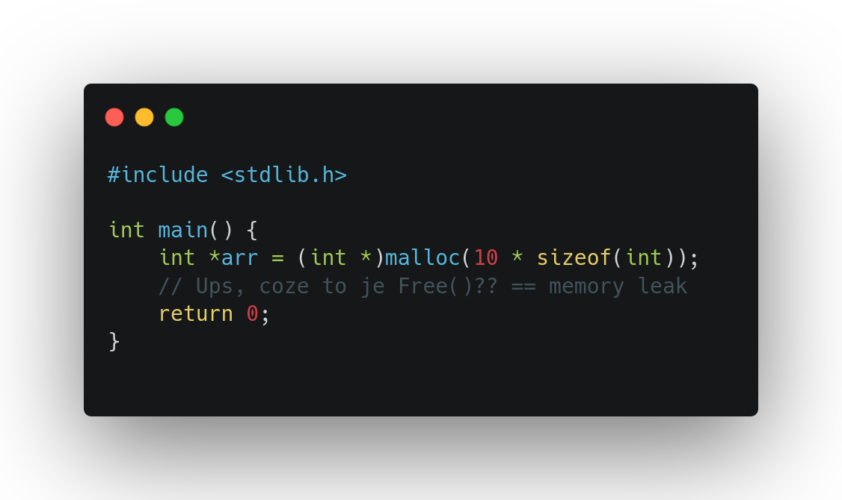
An example in the C lang
Since we forgot to Free() the pointer arr, when the code ends or the pointer goes out of scope, the memory stays allocated on the heap with no reference == LEAK

Slide 4
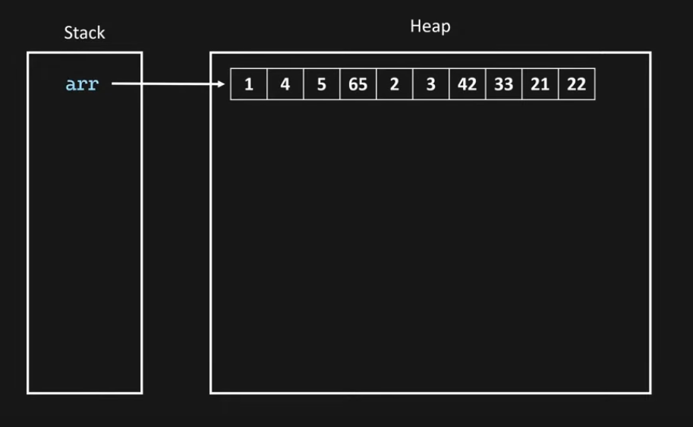
Stack + Heap representation
This is healthy!

Slide 5
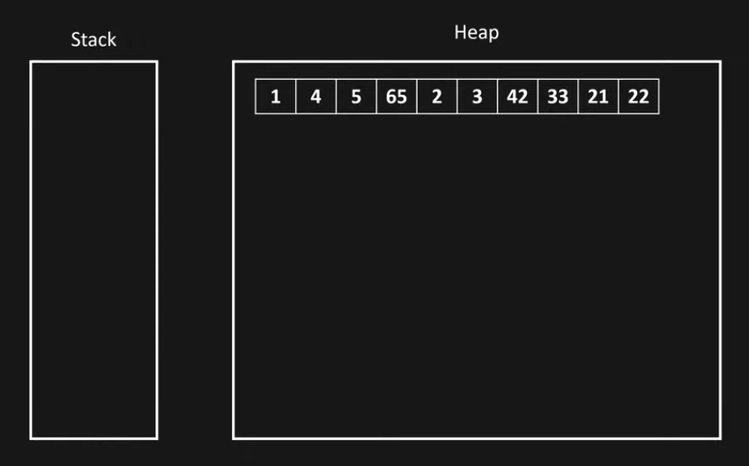
Stack + Heap representation
This is a Leak...

Slide 6
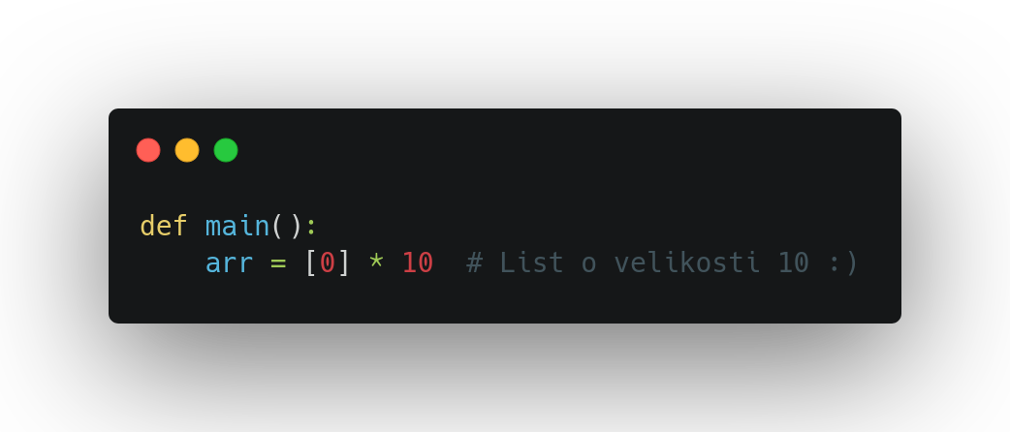
An example in Python
Problem solved, right?

Slide 7
The Garbage Collector
{
Pros
Cons
Automatic memory management
Easier development
Handles cyclic references
Makes Python runtime overhead (which is already crazy slow) even slower
}
*

Slide 8
The problem
< How can we manage memory with no runtime overhead and without leaving it in the hands of incompetent developers? >
*

Slide 9
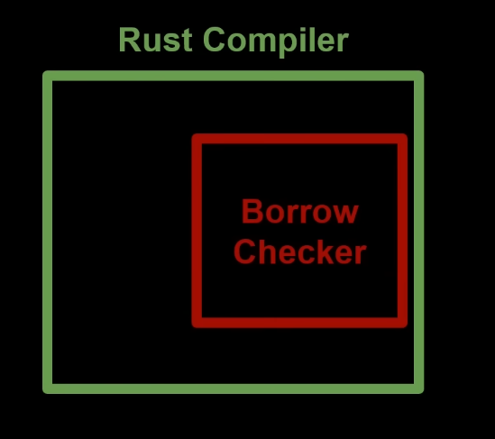
Rust: Making Unsafe Code Impossible
But how?
*

Slide 10
Ownership
and
Borrowing
{
}

Slide 11
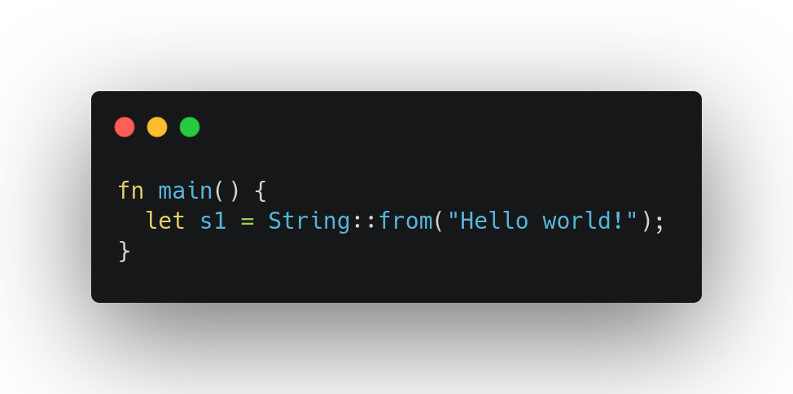
Ownership
Rule 1: Each value in Rust has an owner.

Slide 12
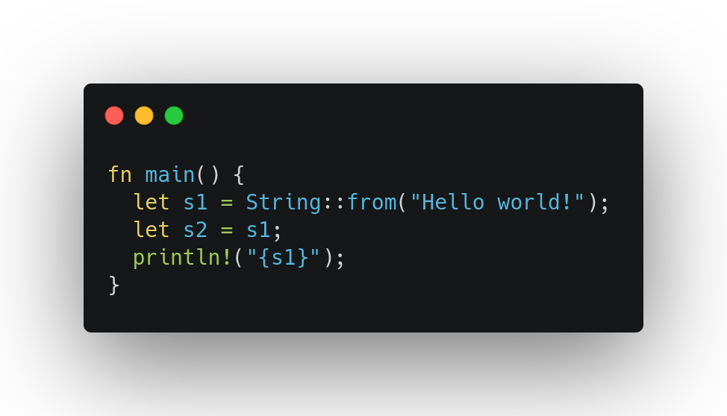
Ownership
Rule 2: There can only be one owner at a time.

Slide 13
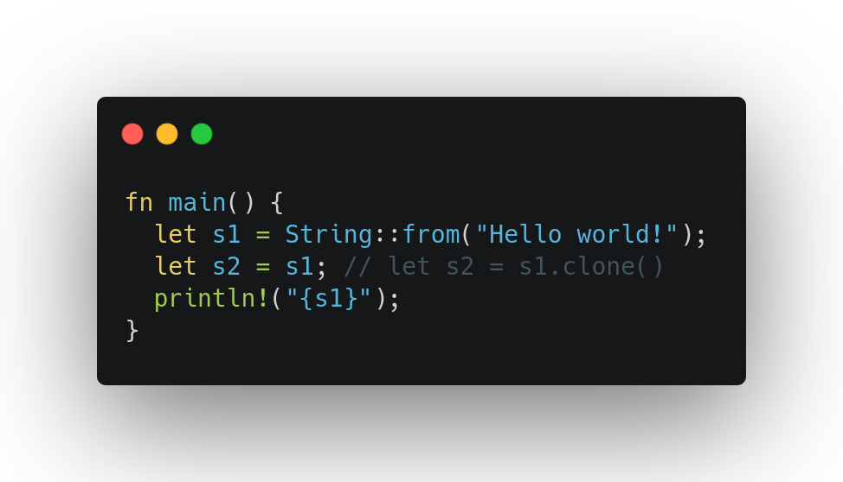
Ownership
borrow of moved
value s1
Rule 2: There can only be one owner at a time.

Slide 14
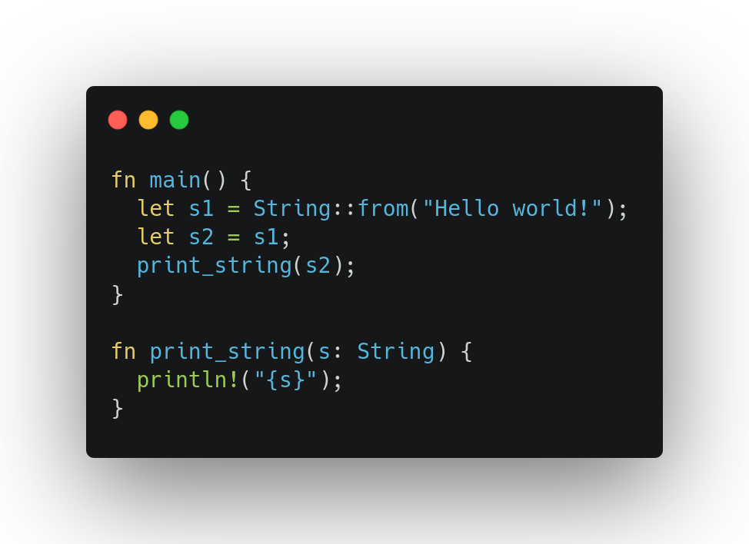
Ownership
Rule 3: When the owner goes out of scope, the value will be dropped.

Slide 15
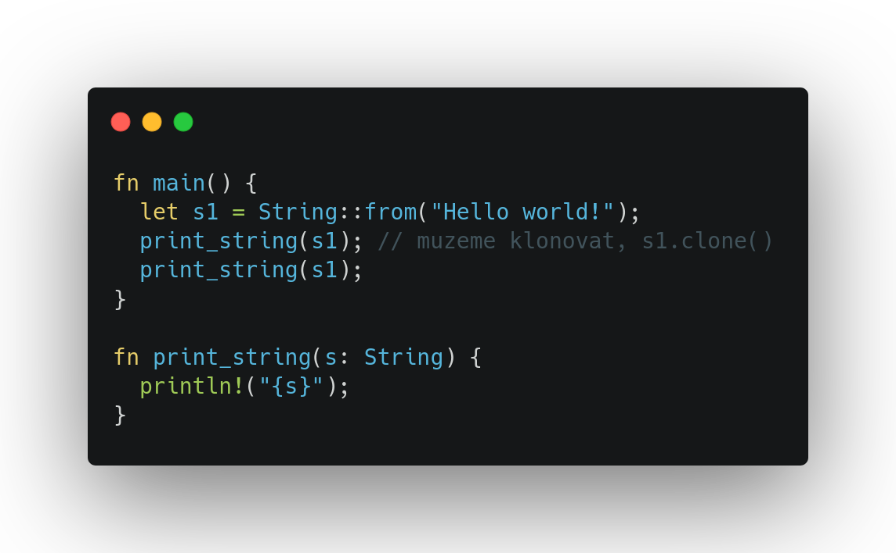
Ownership
use of a moved value: s1
Rule 3: Issues

Slide 16
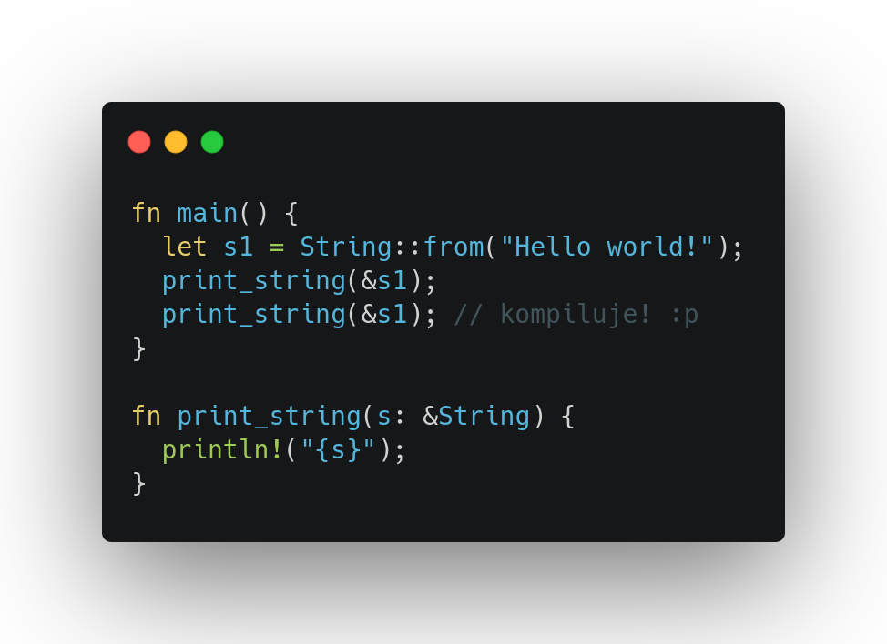
Borrowing
Borrowing = Creating references which can then be borrowed.

Slide 17
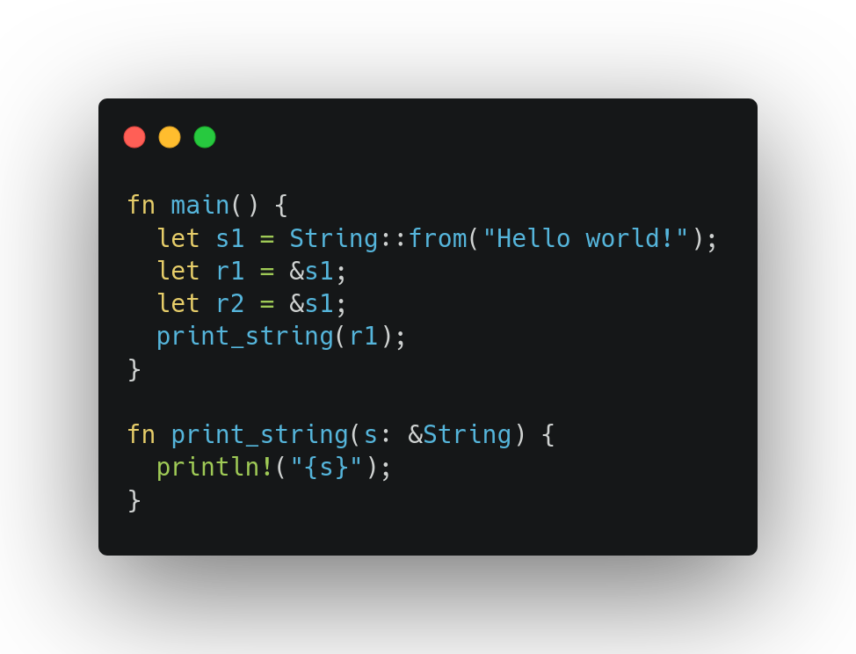
Borrowing
Rule 1: You can either have one mutable reference or any number of immutable references.

Slide 18
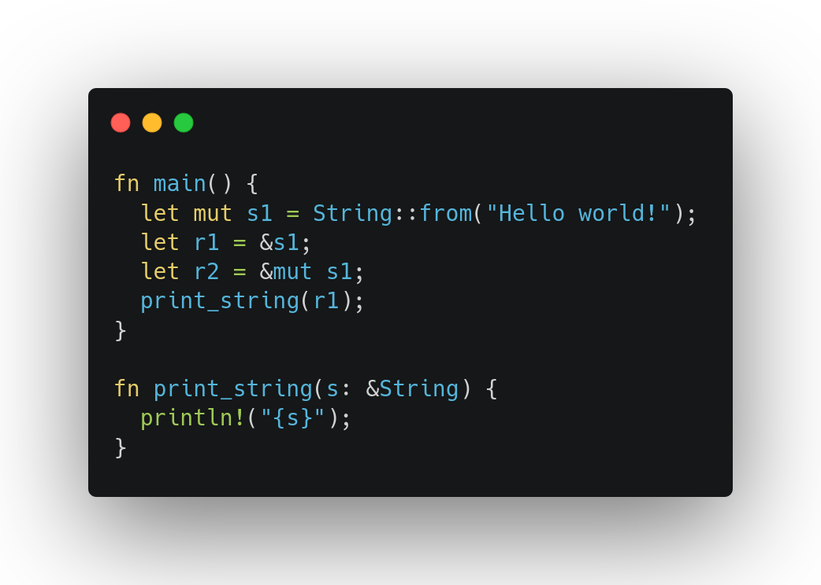
Borrowing
Cannot borrow ‘s1’ as mutable because it is also borrowed as immutable
Rule 1: You can either have one mutable reference or any number of immutable references.

Slide 19
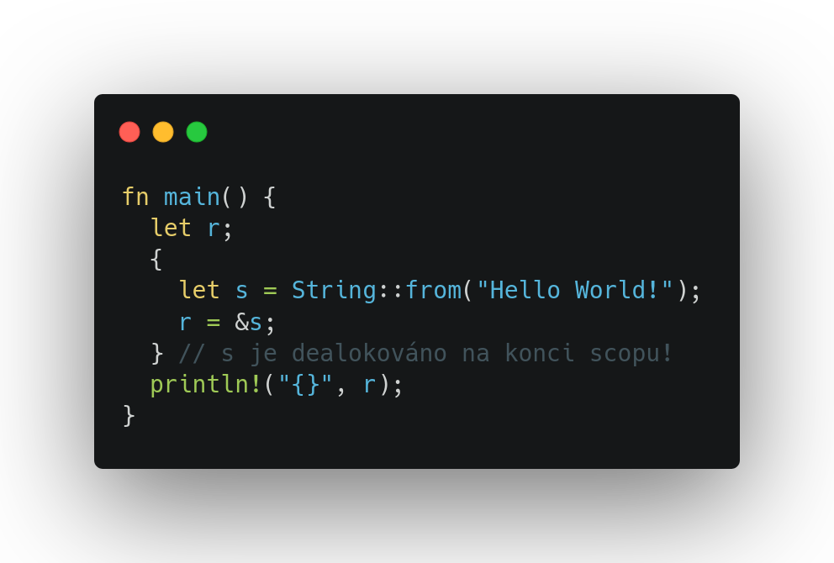
Borrowing
borrowed value does not live long enough
Rule 2: References must always be valid.

Slide 20
And that’s the magic! 🎉
Acknowledgements and caveats:
Tried to keep it really simple and short
Didn’t go into lifetimes and lifetime specifiers (further dive down the rabbit hole highly recommended!)
🦀🦀Learn Rust!!!🦀🦀

Slide 21

Thanks!
< Sources >
https://doc.rust-lang.org/book/
https://malekai.co.uk/posts/Rust/a_brief_introduction_to_memory_management_in_rust

